Slide 1
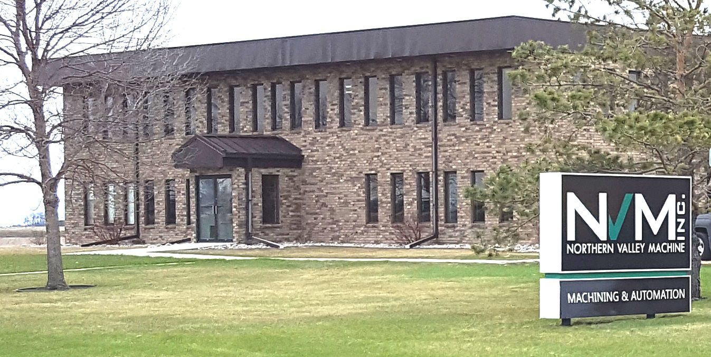
Capabilities and Projects

Slide 2
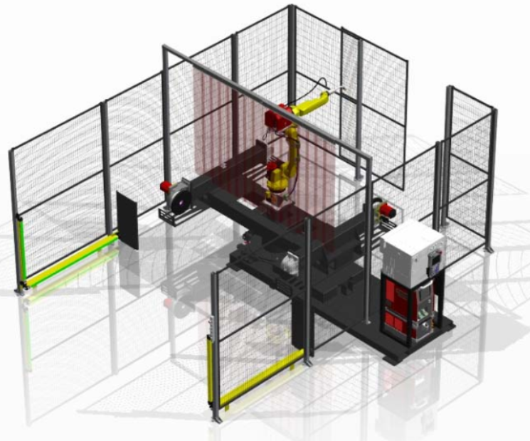
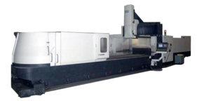
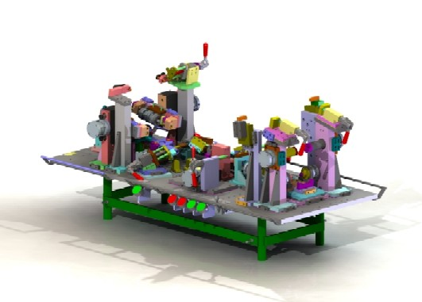
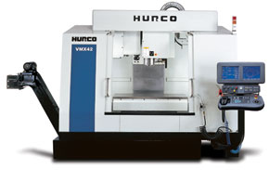
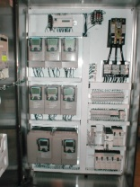
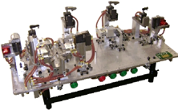
Background
Founded in 1992
Located in East Grand Forks, Minnesota
Approximately 60,000 sq ft
70 employees
UL 508A Listed Panel Shop (File #E251126)
In-house Electrical and Mechanical Engineering
Quality Assurance Department
Fully Staffed Electrical and Mechanical Assembly

Slide 3
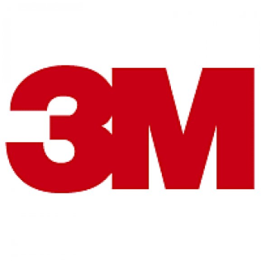
Customers
Industries Served:
Aerospace Equipment Manufacturing
Window Manufacturing
Recreational Vehicle Manufacturing
Agriculture Equipment Manufacturing
Material Handling
Packaging

Slide 4
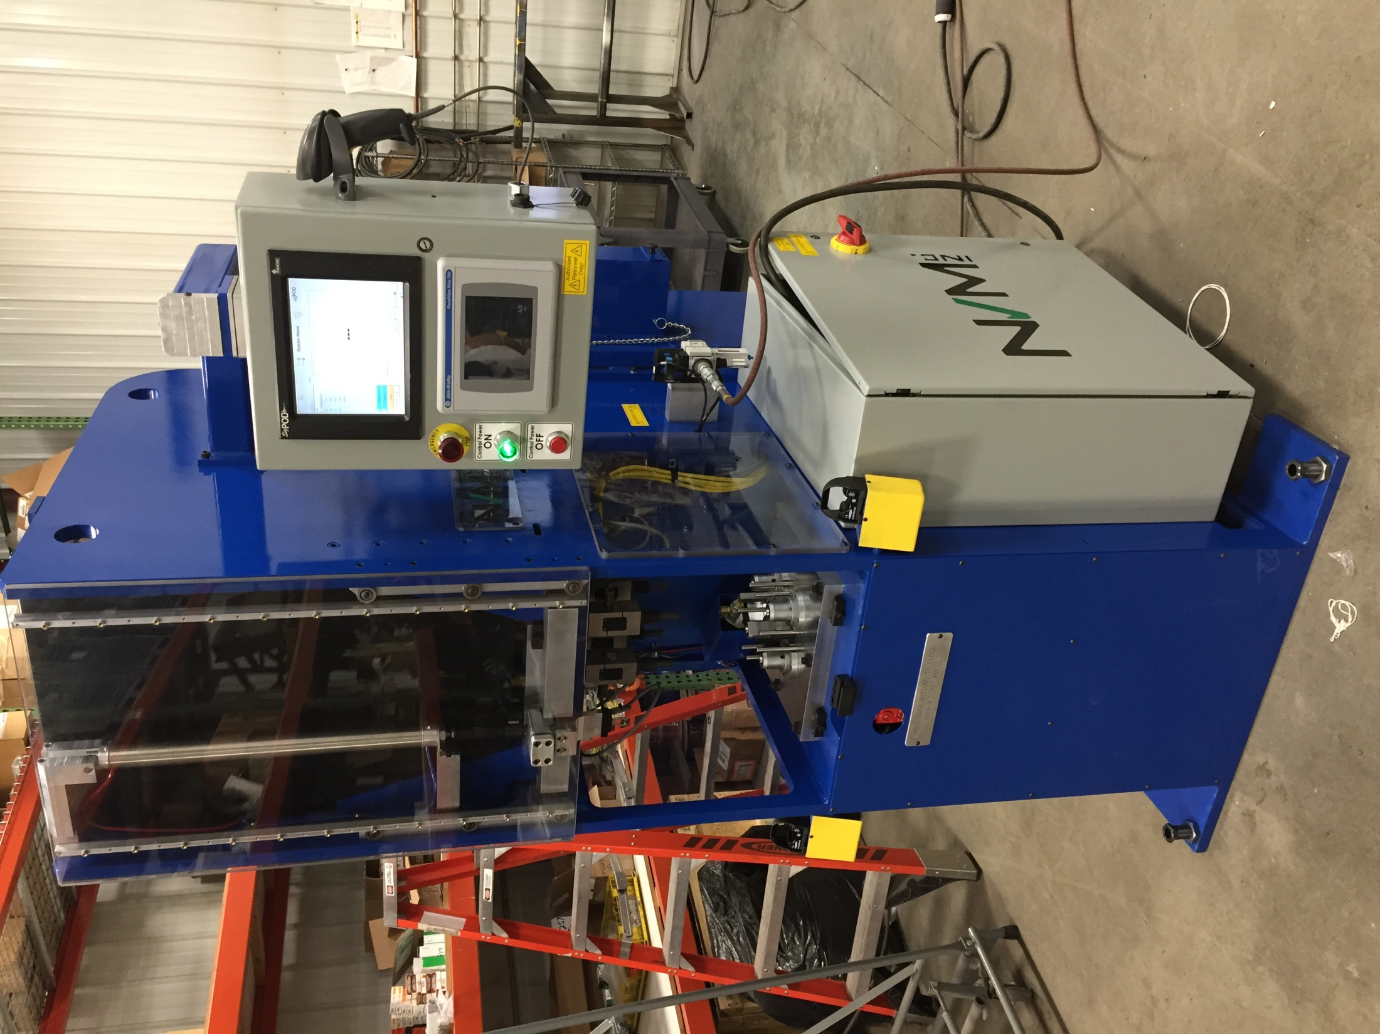
Automation Capabilities Automated Equipment
Component Processing Equipment
Automatic Saws
Automatic Drilling Machines
Automatic Drilling and Grinding Machine
Automated Punch Press
Drill and Notch Machine
Ergonomic Lift Assist

Slide 5
Automation Mobile Robotic Drilling and Fastening System
For this project the customer provided a full design of the machine. Northern Valley Machine reviewed the mechanical and electrical design with our engineers and built the machine to print with some minor changes.
Northern Valley Machine Responsibility
Redesign parts so they can be manufactured
Machine all parts and weldments
Assemble all parts
Assemble electrical panels

Slide 6
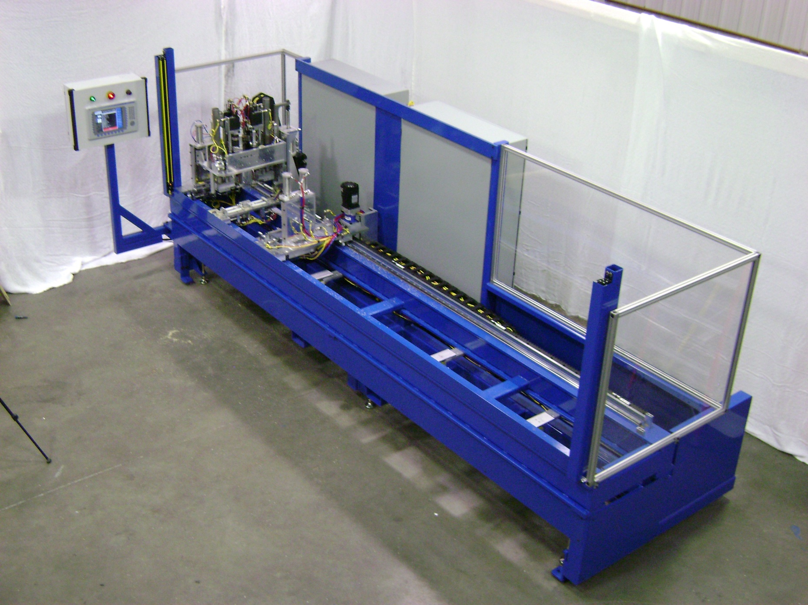
Automation Capabilities Automated Equip. – Automatic Drilling – Variable Hole Location
Part Lengths 24”-144”
Infinite Part Lengths
Length Verified before Drilling
Custom code developed for each length
Positional accuracy within 0.002”

Slide 7
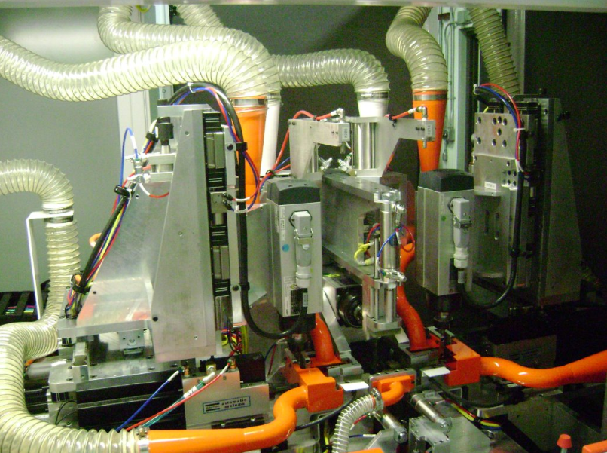
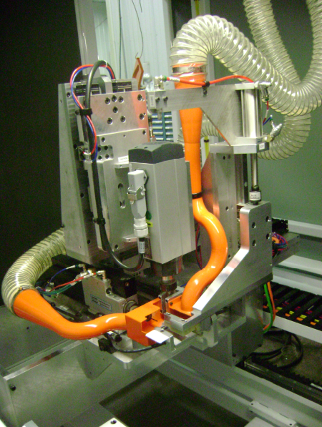
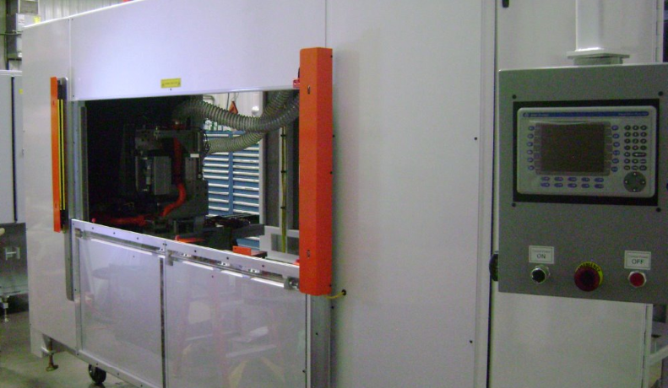
Automation Capabilities Automated Equip. – Component Fabrication Machine
Machine wood parts for a window sash
9 different fabrication operations
Servo controlled coordinated motion

Slide 8
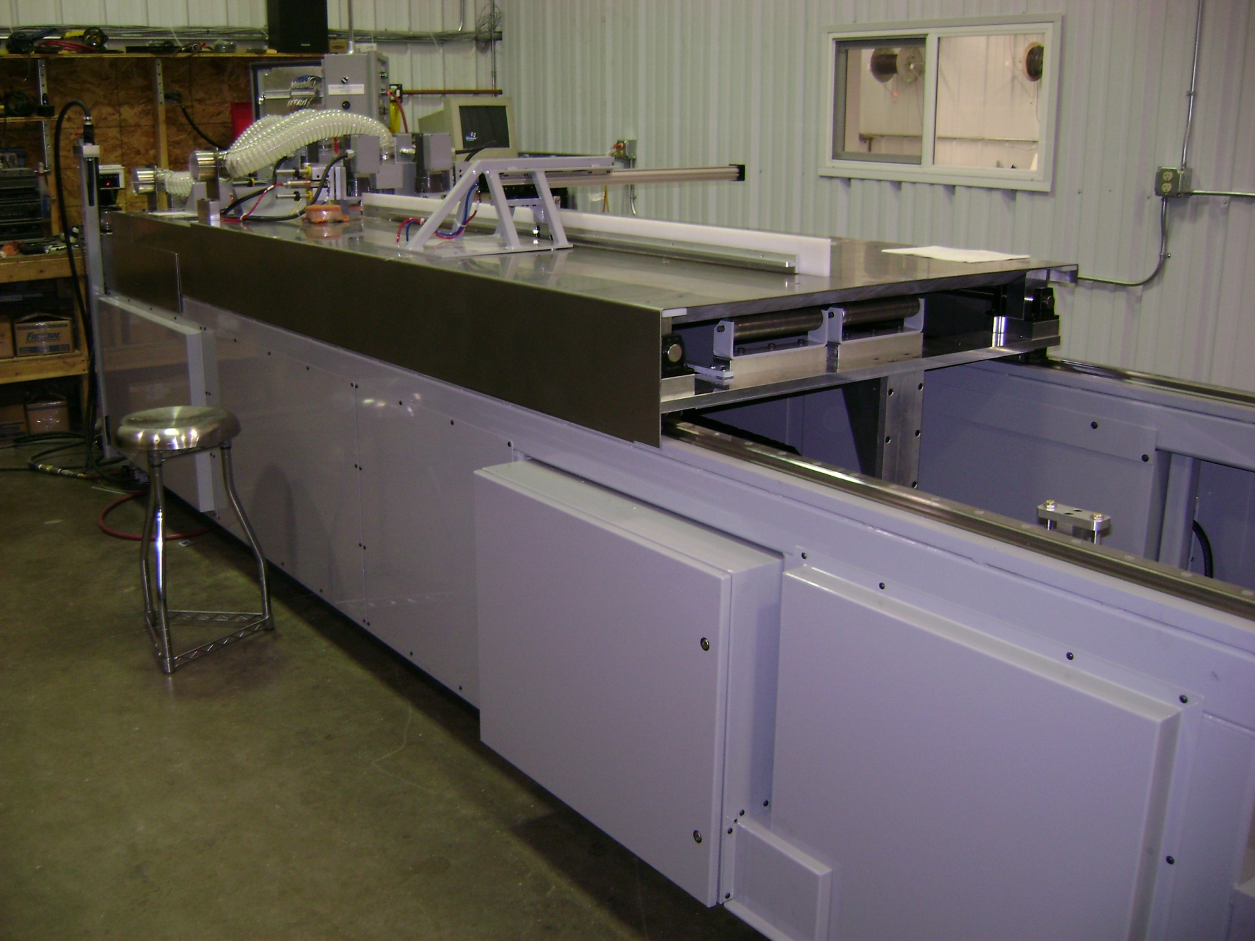
Automation Capabilities Automated Equip. – Automatic Saws
NVM designed and developed a series of linear saws to cut continuous flow-rate material off of a pultrusion machine. By setting the length of cut and miter angle, the saw could continuously monitor the feed rate of material and cut stock lengths accurate to 0.003”, all without interrupting material feed.

Slide 9
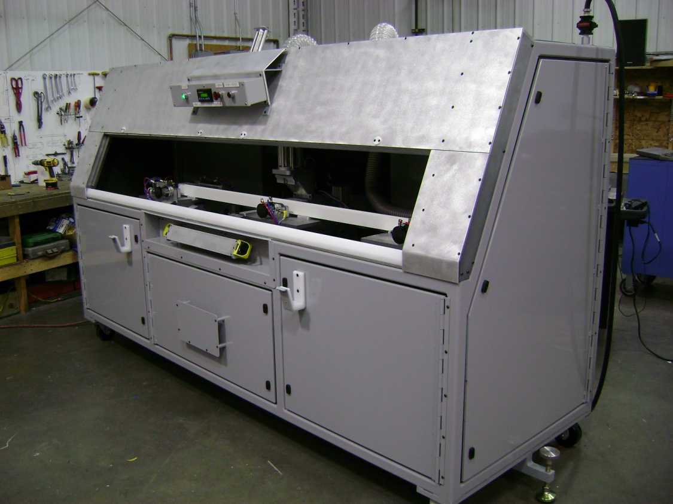
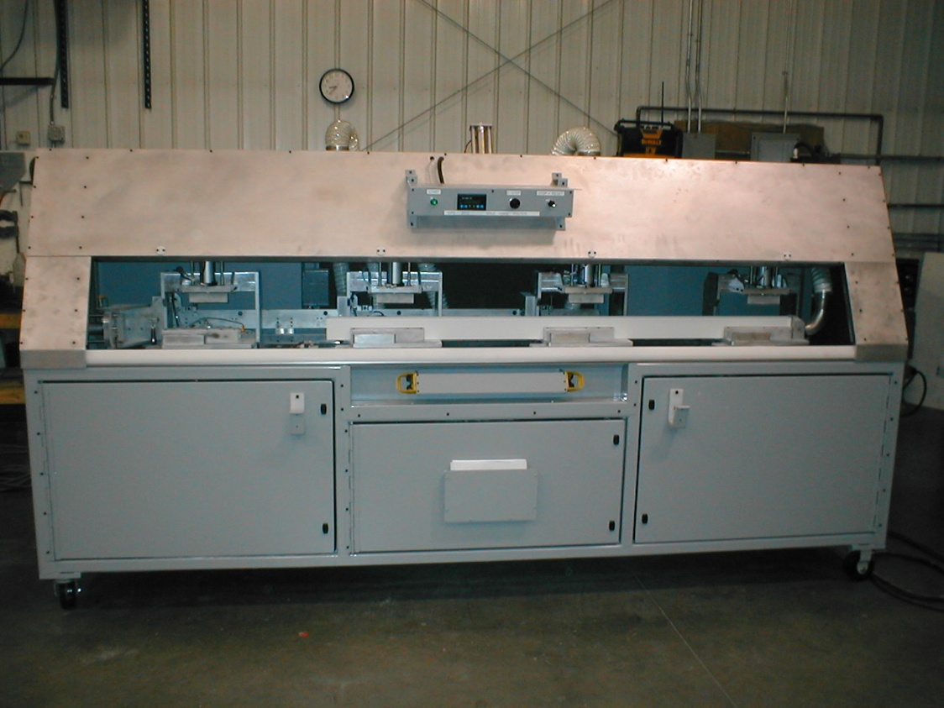
Automation Capabilities Automated Equip. – Automatic Drilling & Grinding Machines
Nearly every automated drilling and grinding machine featured a full enclosure, complete with sound proofing foam inside and access panels around the perimeter. Dust collection was provided at every point of operation, and the custom machine frame housed the electrical and pneumatic panels.

Slide 10
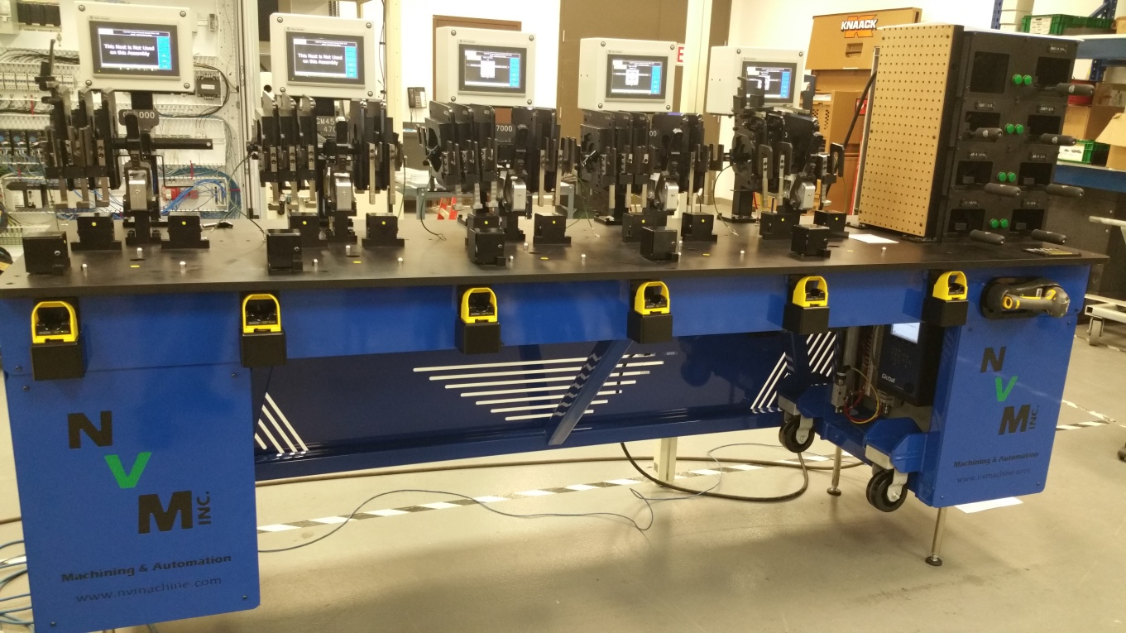
Smart Assembly Stations
RFID technology to verify correct adaptor
Logging
Torque
Time/Date
Model
Serial Number
HMI walks operator thru assembly for each station
Clocking Arms for fittings
Smart torque wrench tool holder
Adjustable Height
Notes:
This project the customer was having issues with their assemblers not torquing every fitting on a hydraulic motor. The other issue was the fittings were not put on at the right angle so they would be loosened and retightened on the assembly line.

Slide 11
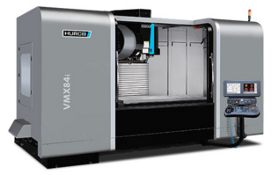
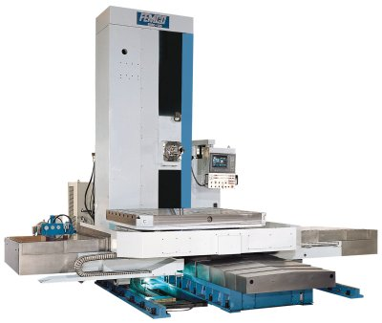
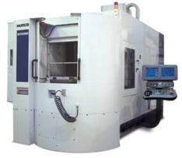
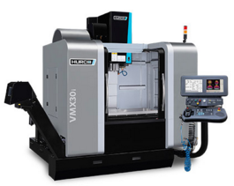
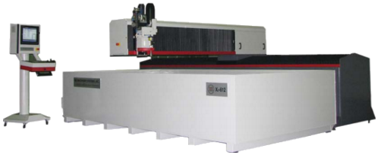
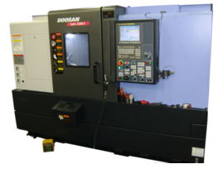
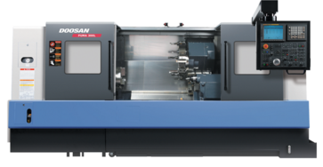
Machining
2 shifts of production
Short Term to Long Term production
Prototype Machining
Gibbs CAM software
5 Axis CNC Mill
10 Vertical CNC Mills
2 Horizontal CNC Mills
1 Waterjet
2 Bridge Mills
2 Boring Mill
4 CNC Lathes
2 EDM Machines
3 Grinders

Slide 12
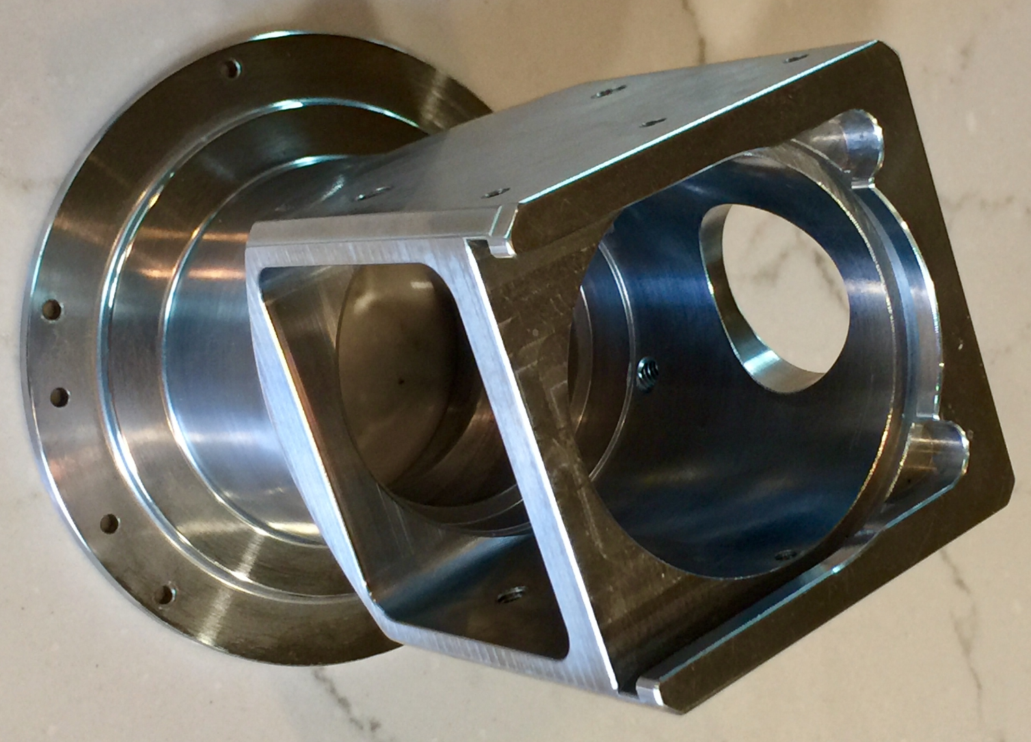
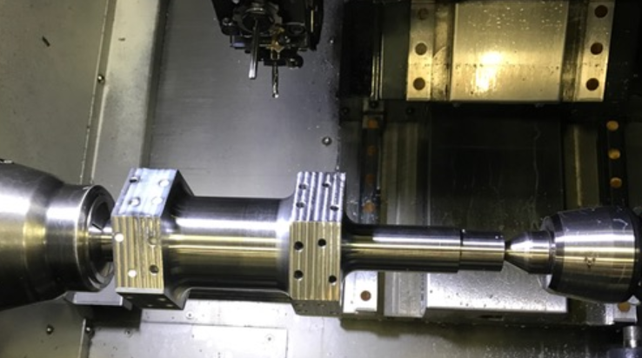
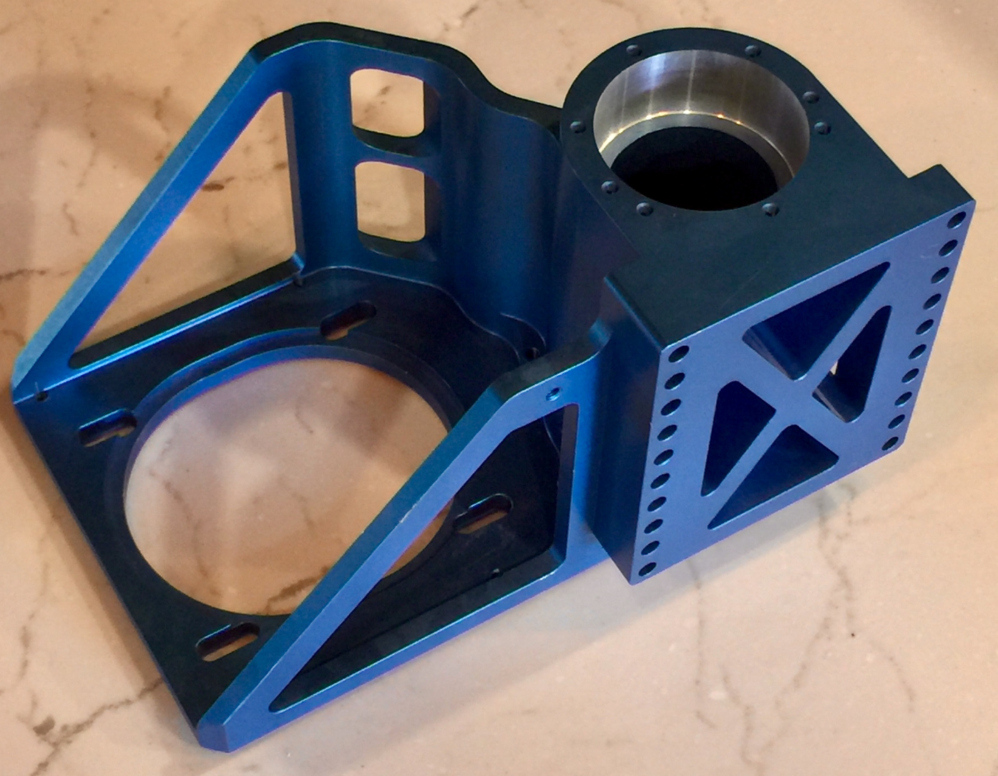
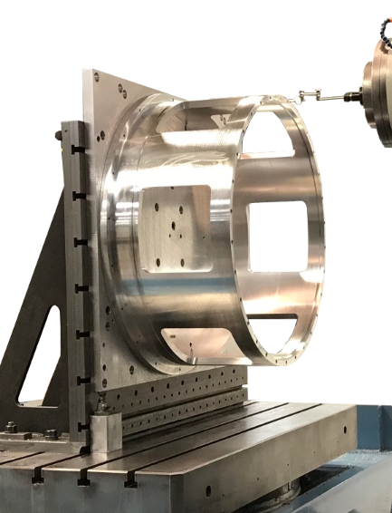
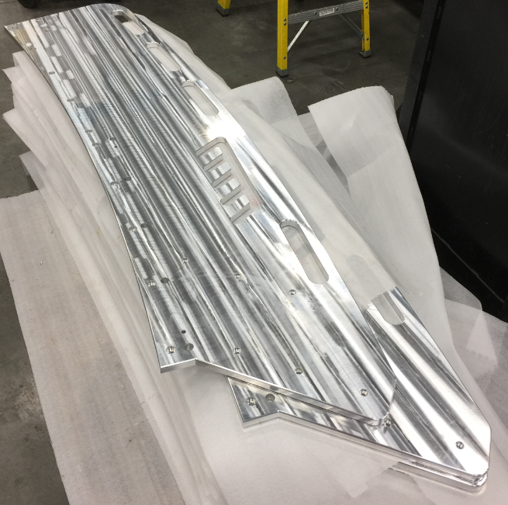
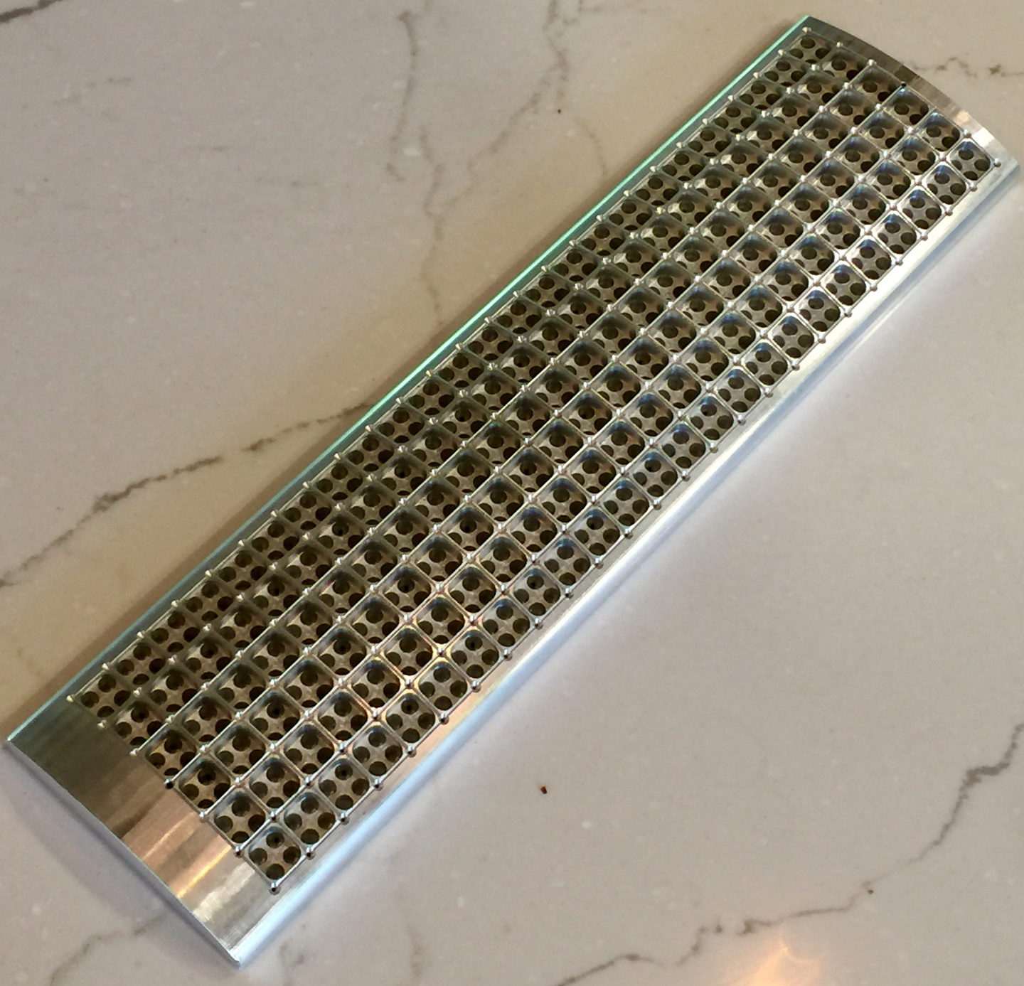
Machining Machining Examples

Slide 13
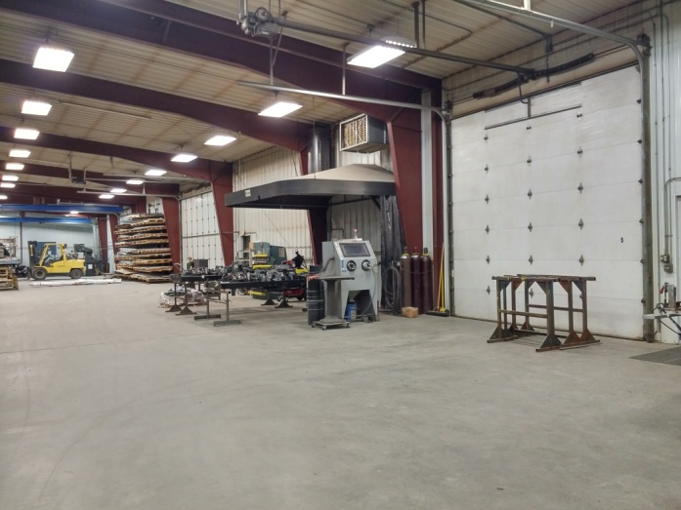
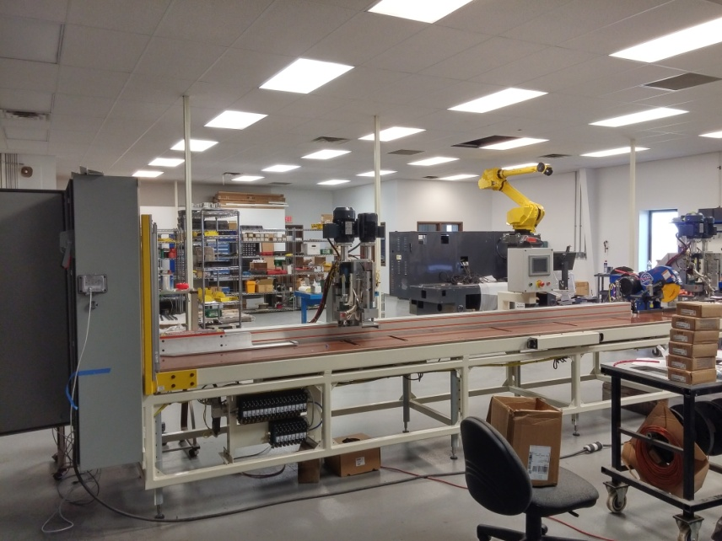
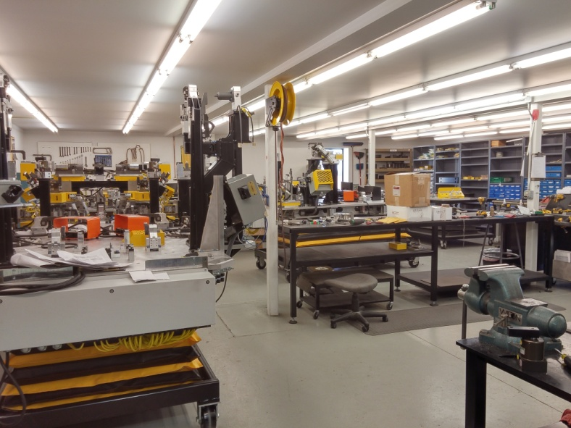
Assembly
Assembly Capabilities
Separate electrical and mechanical assembly rooms
Secure key card access to assembly areas
Overflow assembly for large projects

Slide 14
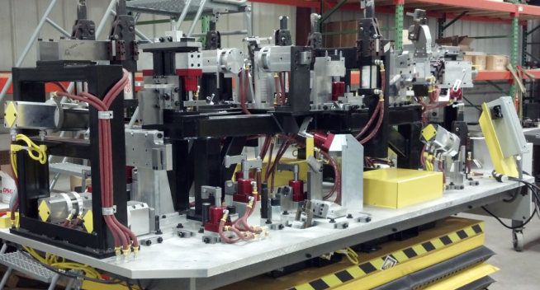
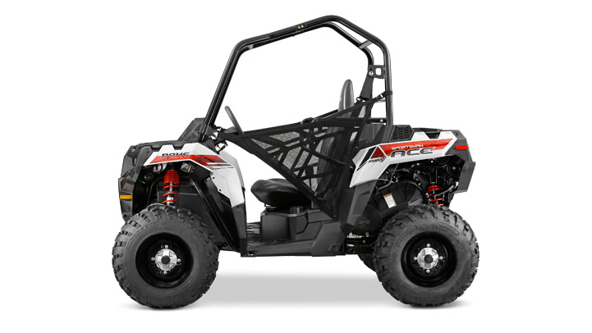
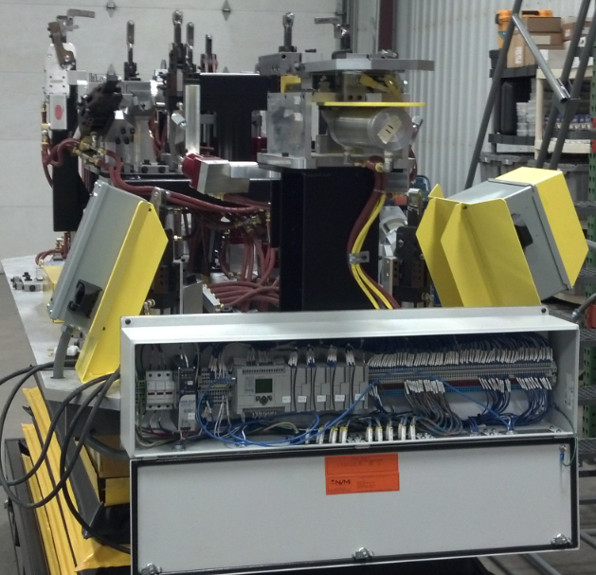
Weld Fixtures Manual Frame Welding – PLC Controls
Sportsman ACE Vehicle Frame
Marriage fixture to hold multiple subweldments together for final welding.
PLC Controlled with Prox Switch Feedback on fixture positions.
Dual Operator Control

Slide 15
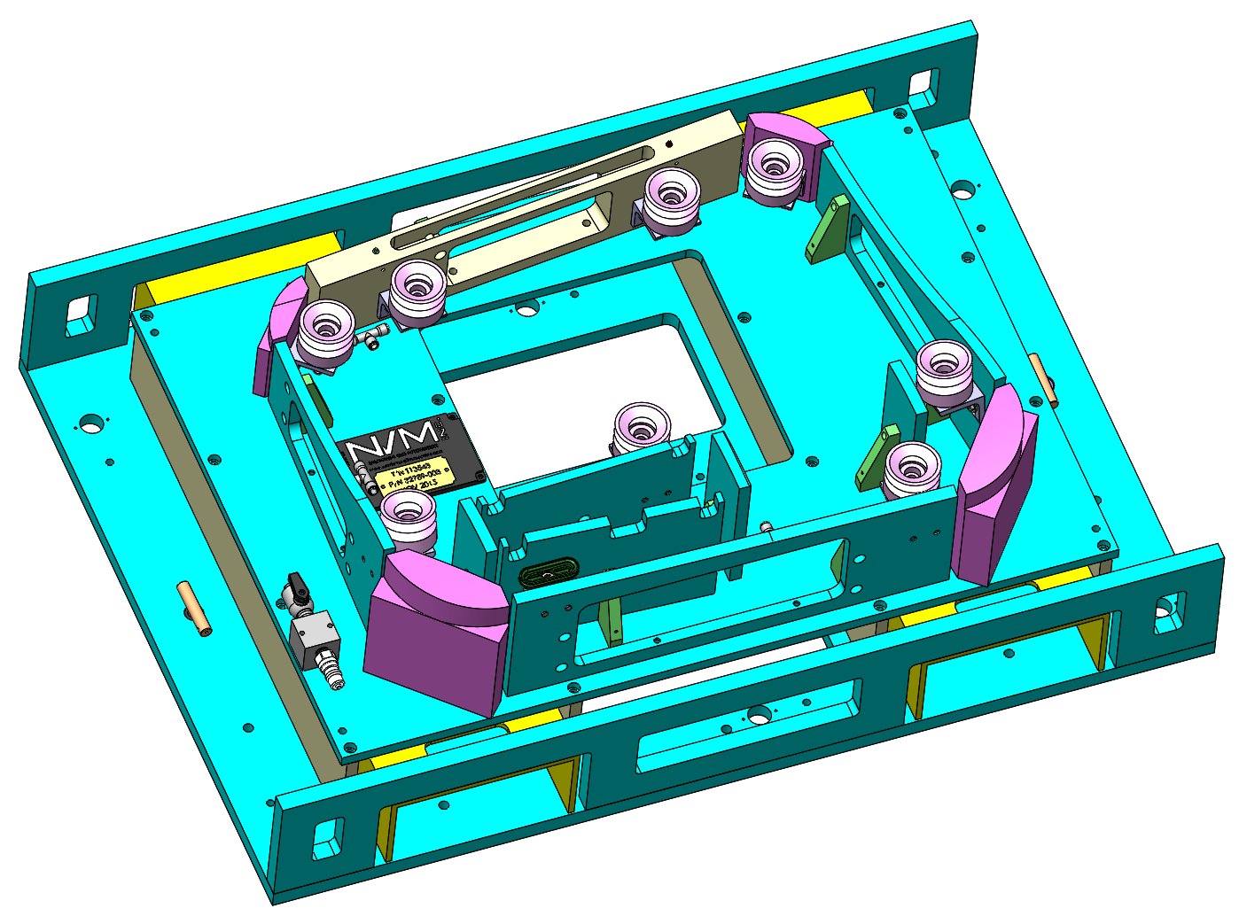
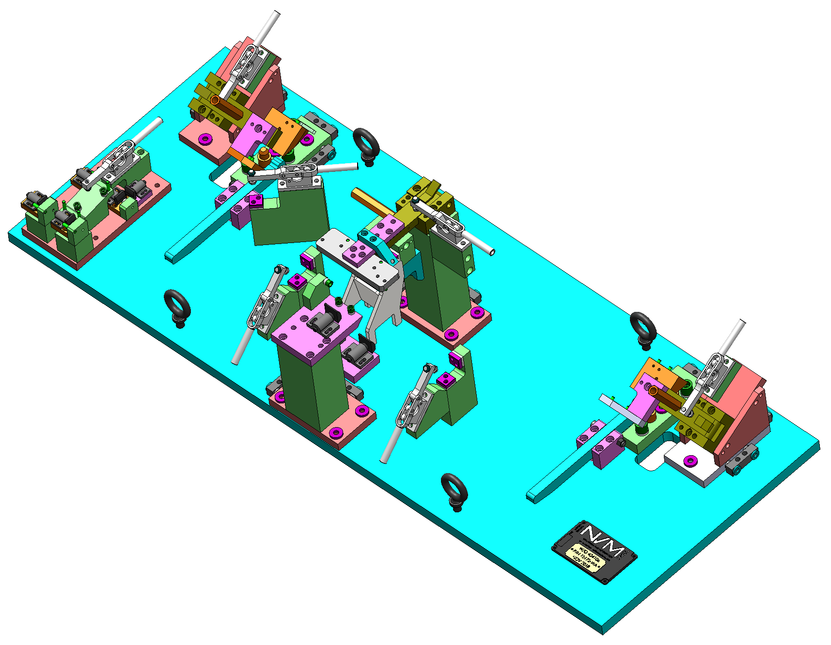
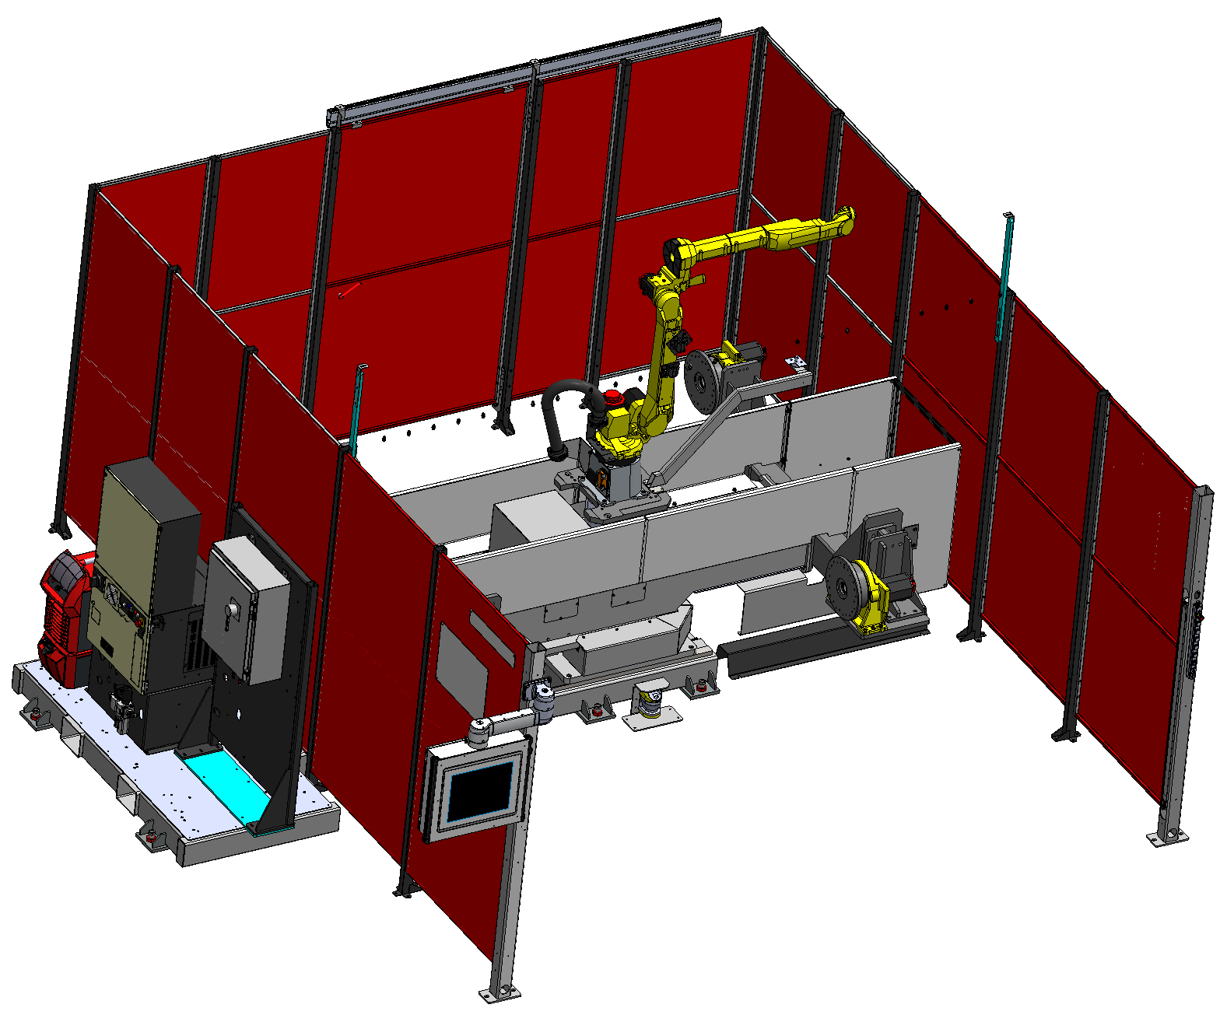
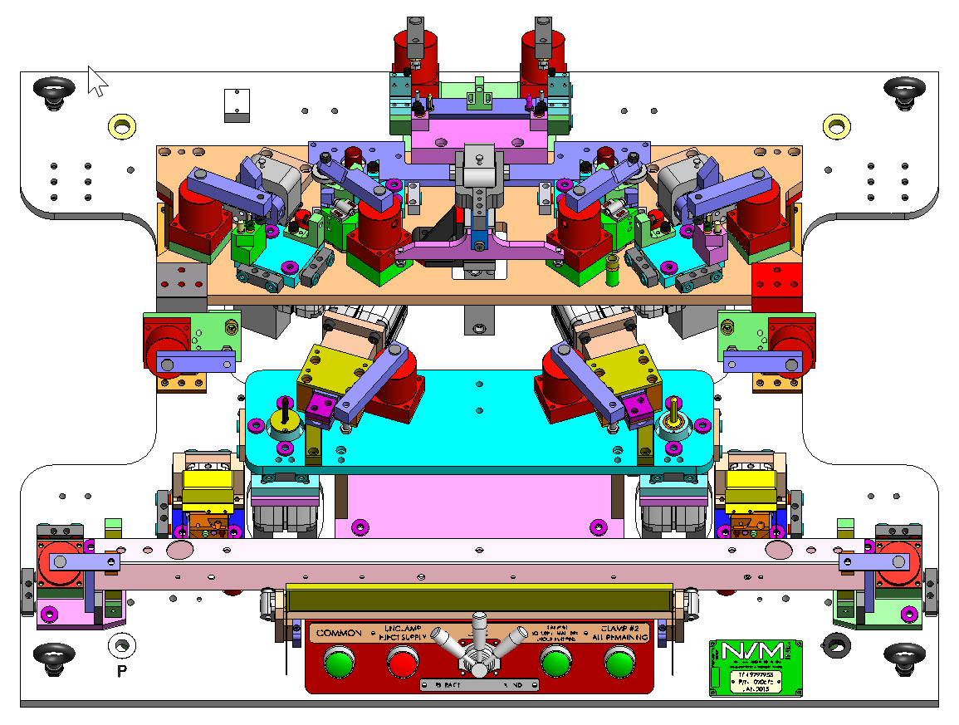
Modeling Software
Solidworks 3D Solid Modeling
Solidworks Electrical

Slide 16
Welding Automation Fanuc / Lincoln Electric Robotic Integrator
Fanuc / Lincoln Robotic Integrators
Turn Key Weld Cell Solutions
Robotic Weld Cell Integration
Weld Fixtures
Quick Removal Picture Frames

Slide 17
Holding Fixtures
Vacuum Holding Fixture for 5-Axis CNC Router

Slide 18
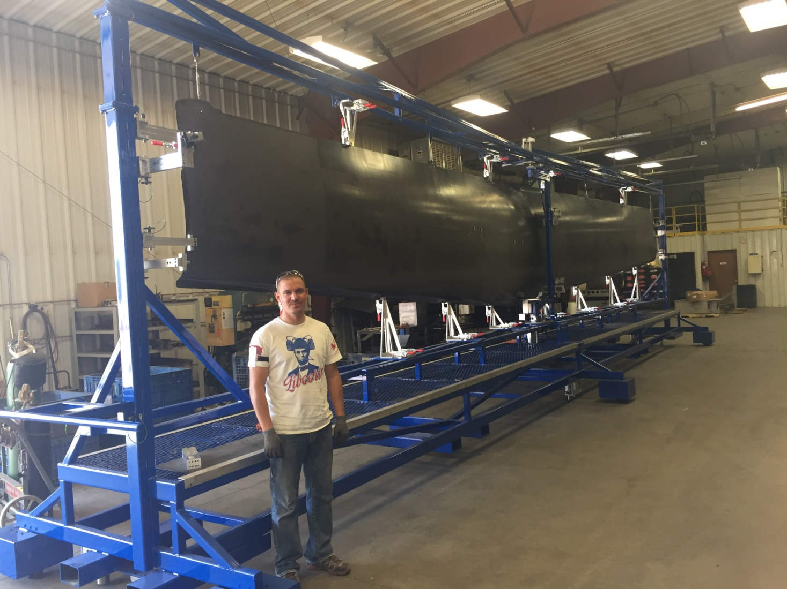
Inspection Fixtures
Fixture Details
42’ long x 11’ tall x 7’ wide
Interchangeable quick change details
Important details have shim-ability
Pins for locating fixture
Inspection fixture for Non Destructive Testing

Slide 19
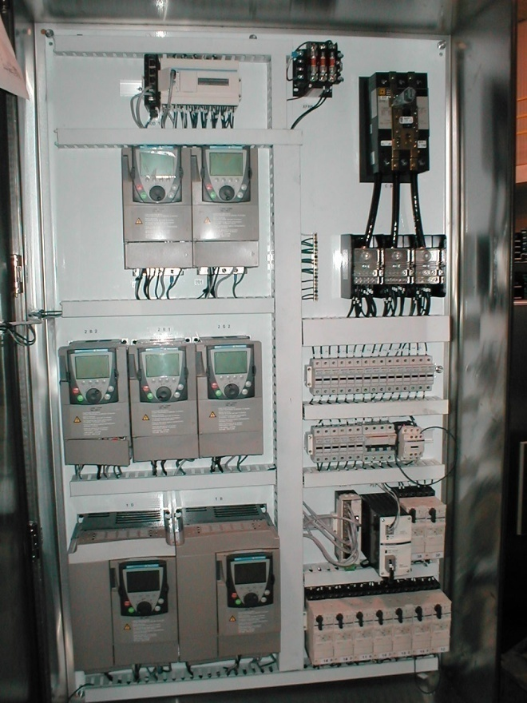
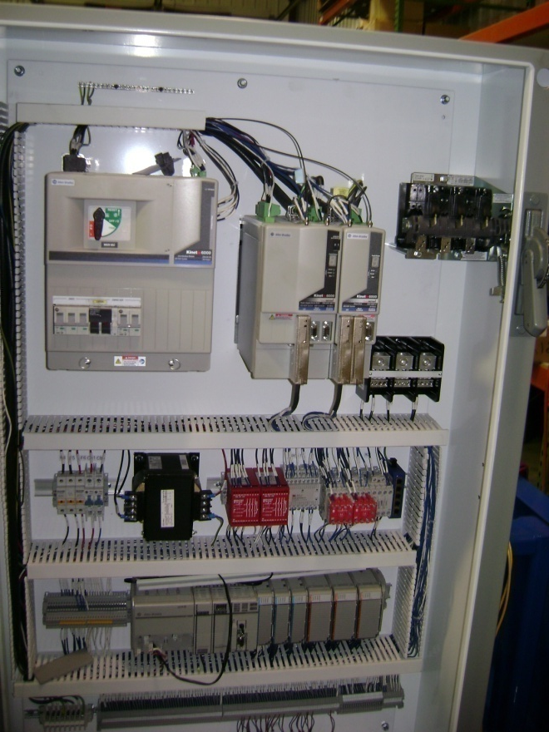
UL 508A Panel Shop
Schematics
Panel Layouts
PLC Programming
Field Wired to Terminal Blocks
Built to customer specifications
Prefer COTS parts
Panels are UL Listed

Slide 20
Documentation
Documentation is created and released in electronic format
3D Solid model
Schematics *
PLC Program
Operator Manual *
Maintenance Manual *
Bill of Material
Wear Parts Prints *
* Provided in Printed media in addition to the electronic format.

Slide 21
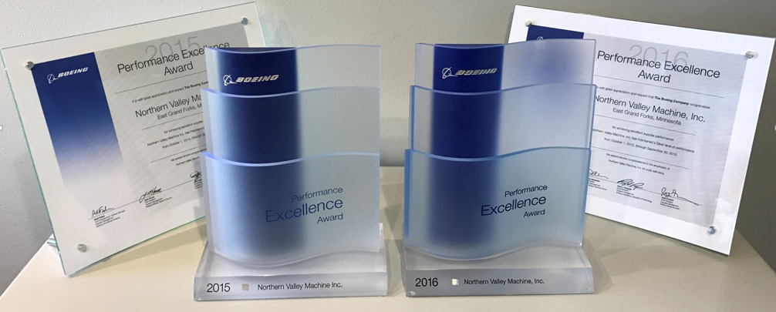
Why NVM?
Fast
One Shop Stop
Design
Mechanical Design
Electrical Design
Programming
Machining
Assembly
Fabrication
Inspection
Quality

